Slide 1
Machine Learning
Predict the outcome of a league of legends game

Slide 2

What is League of Legends?
League of Legends is a MOBA (multiplayer online battle arena) where 2 teams (blue and red) face off. There are 3 lanes, a jungle, and 5 roles. The goal is to take down the enemy Nexus to win the game.

Slide 3
The DATA
The dataset contains the first 10min. stats of approx. 10k ranked games (SOLO QUEUE) from a high ELO (DIAMOND I to MASTER). Players have roughly the same level.
Each game is unique. The gameId can help you to fetch more attributes from the Riot API.
There are 19 features per team (38 in total) collected after 10min in-game. This includes kills, deaths, gold, experience, level… It's up to you to do some feature engineering to get more insights.
The column blueWins is the target value (the value we are trying to predict). A value of 1 means the blue team has won. 0 otherwise.

Slide 4
Glossary
Warding totem: An item that a player can put on the map to reveal the nearby area. Very useful for map/objectives control.
Minions: NPC that belong to both teams. They give gold when killed by players.
Jungle minions: NPC that belong to NO TEAM. They give gold and buffs when killed by players.
Elite monsters: Monsters with high hp/damage that give a massive bonus (gold/XP/stats) when killed by a team.
Dragons: Elite monster which gives team bonus when killed. The 4th dragon killed by a team gives a massive stats bonus. The 5th dragon (Elder Dragon) offers a huge advantage to the team.
Herald: Elite monster which becomes summonable when killed by the player. It helps push a lane and destroys structures.
Towers: Structures you have to destroy to reach the enemy Nexus. They give gold.
Level: Champion level. Start at 1. Max is 18.

Slide 5
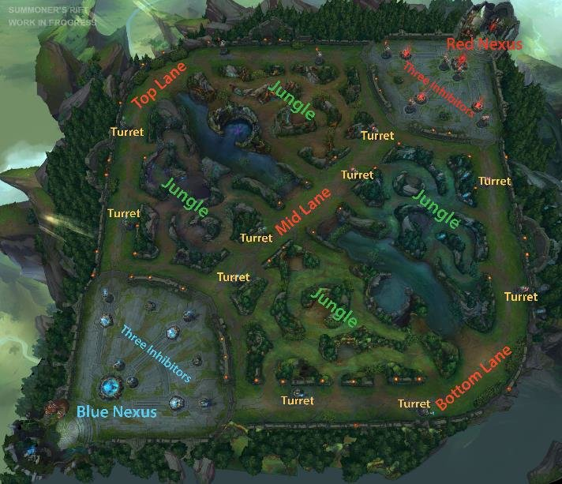
Map

Slide 6
Visualize the Data with Tableau
https://public.tableau.com/profile/jonathan.wu1468#!/vizhome/LeagueofLegendsAnalysisDiamondRankat10min/LeagueStory

Slide 7
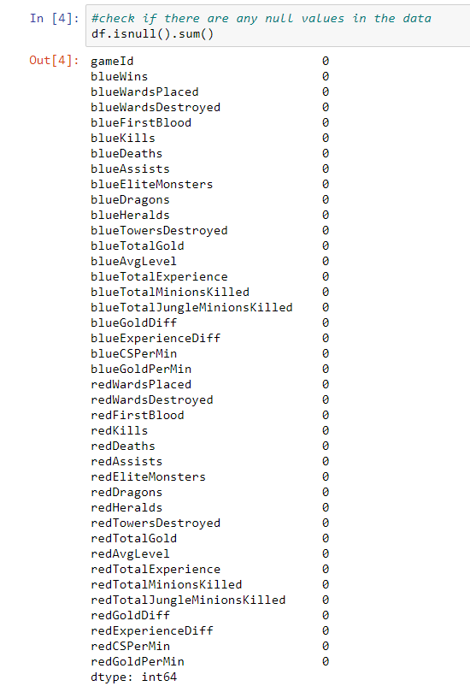
Check for null values

Slide 8
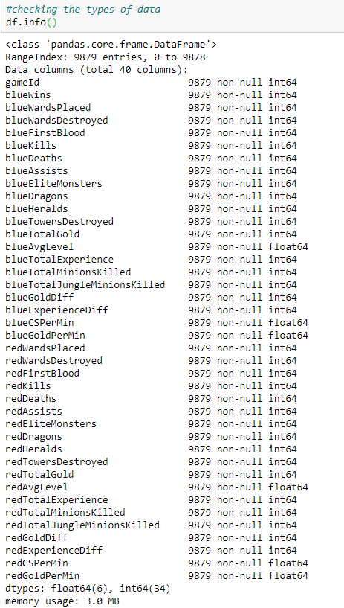
Check the Data types

Slide 9
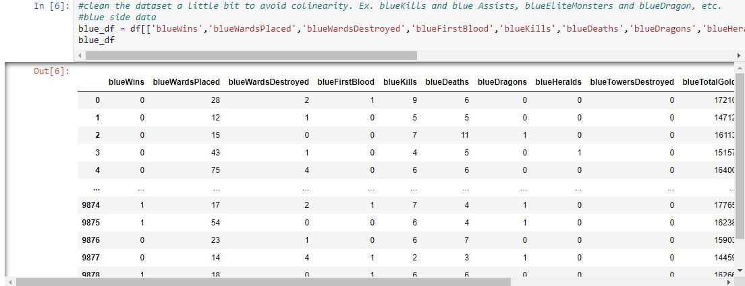
Blue side data

Slide 10
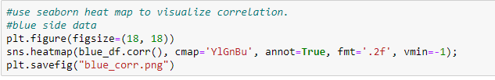
Using seaborn to visualize correlation

Slide 11
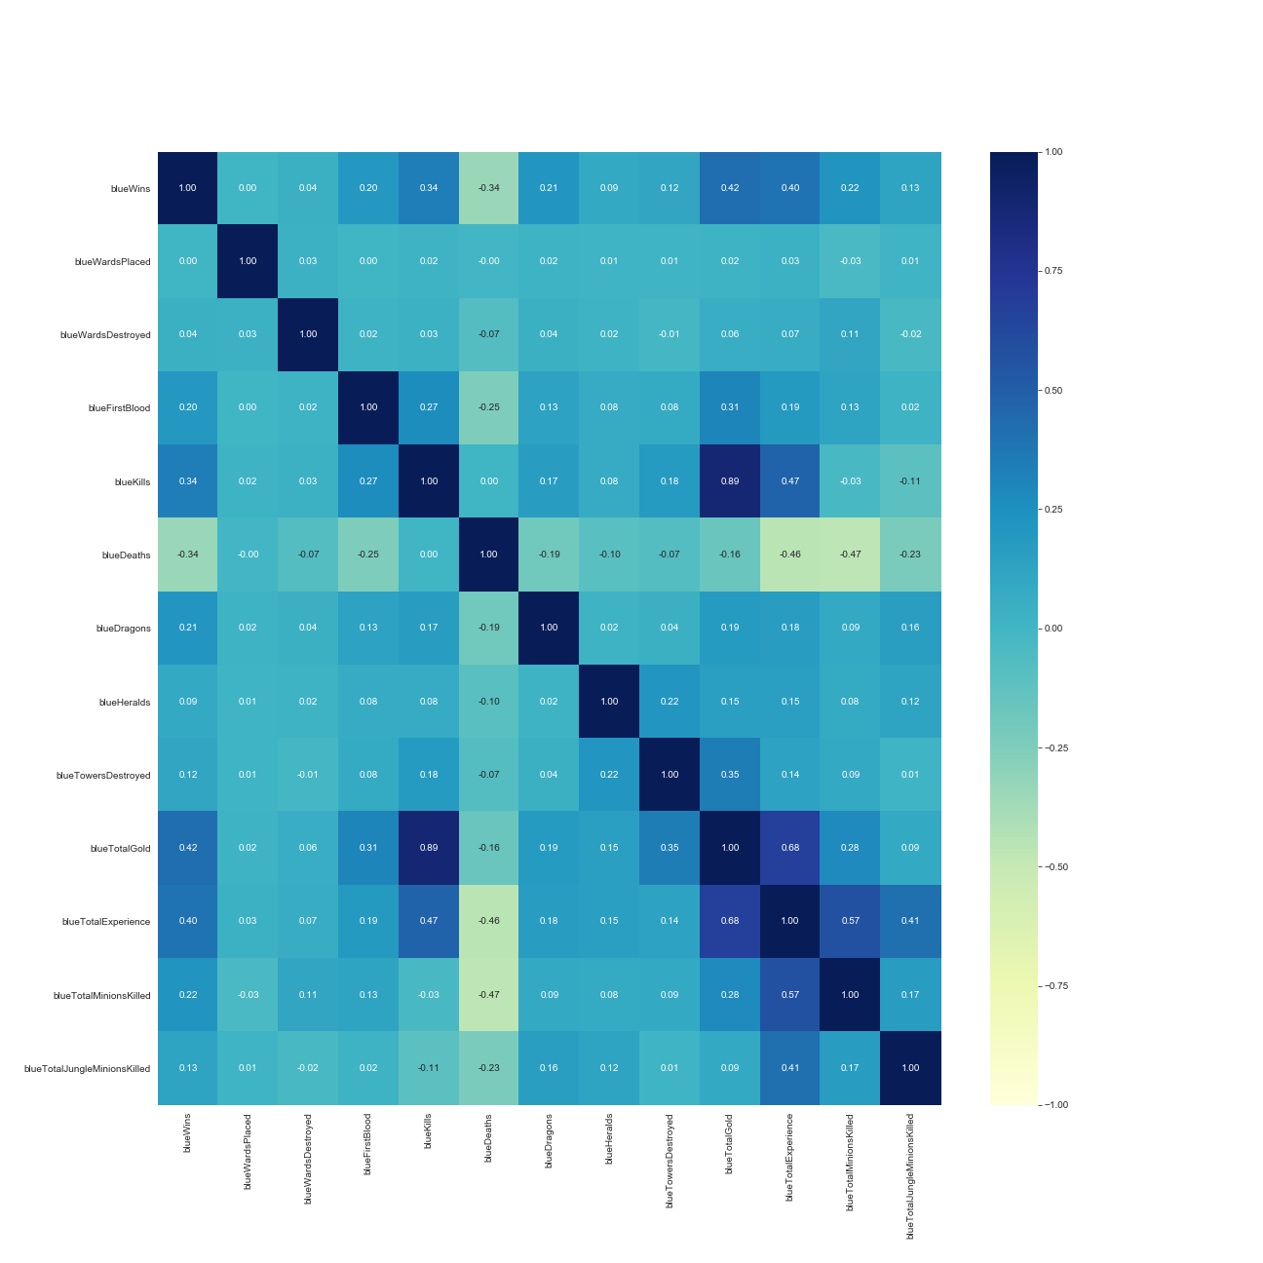
Blue corr

Slide 12
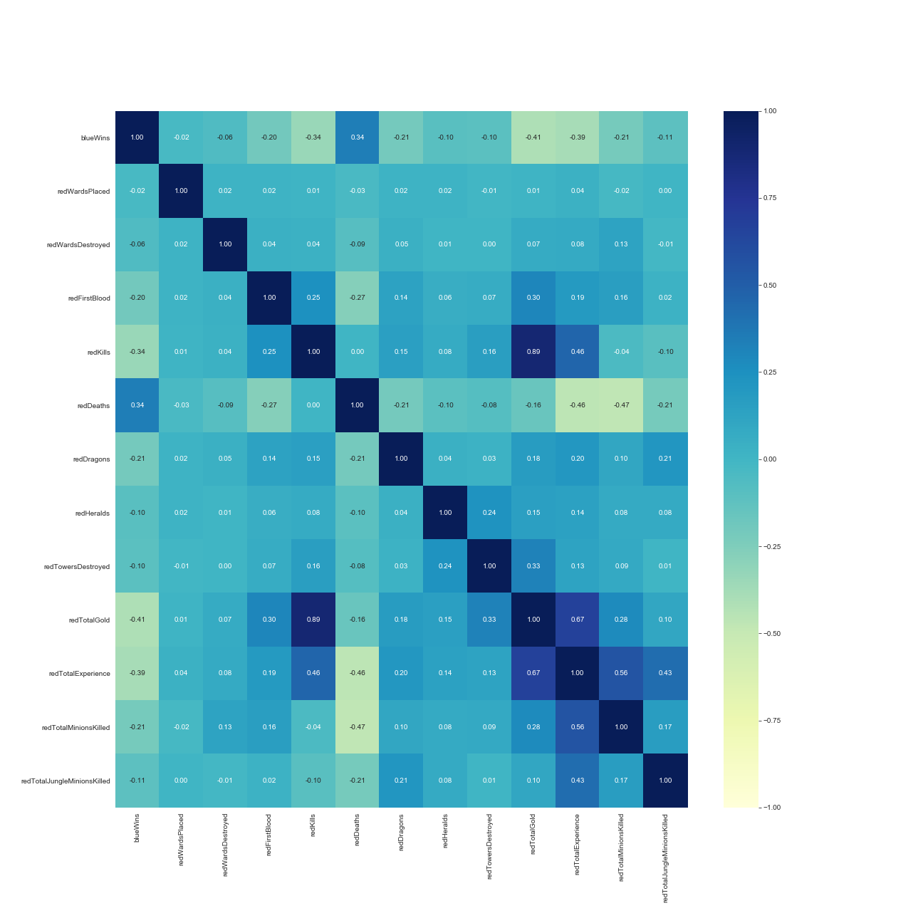
Red corr

Slide 13
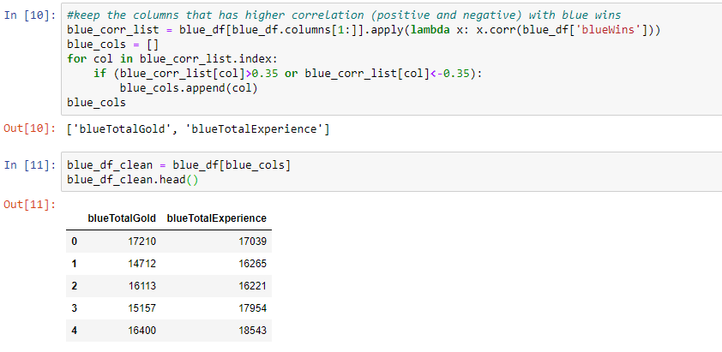
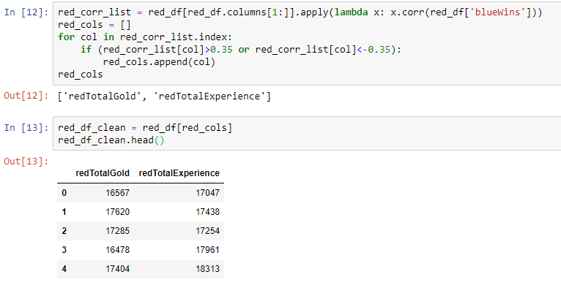
Select the highest correlated columns

Slide 14
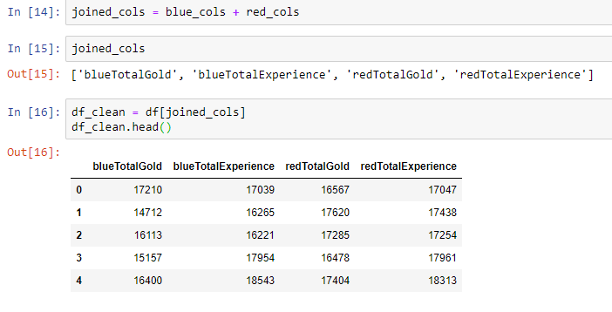
Final dataframe before machine learning

Slide 15
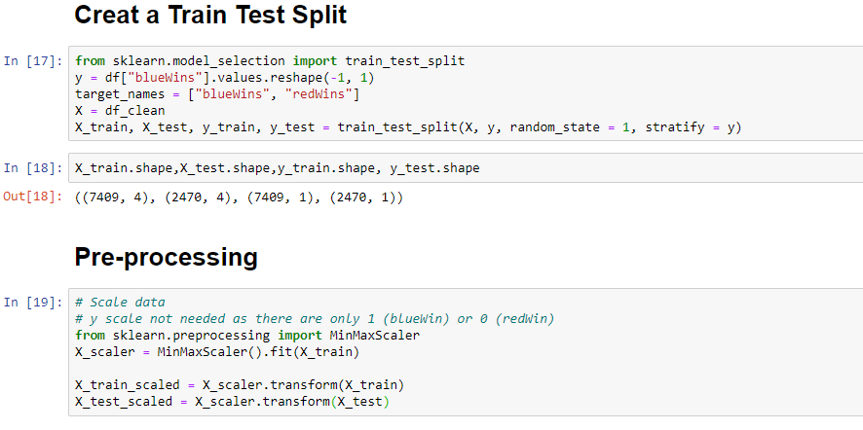
Pre-processing

Slide 16
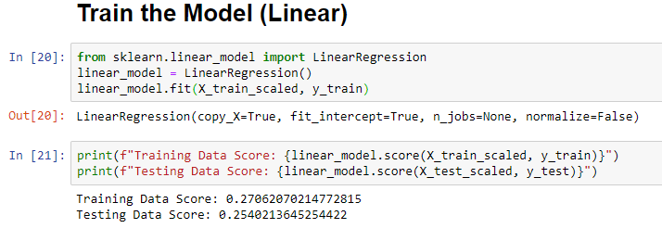
Linear Regression Result

Slide 17
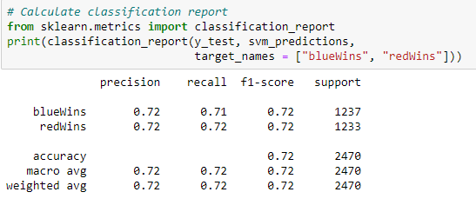
SVM Result

Slide 18
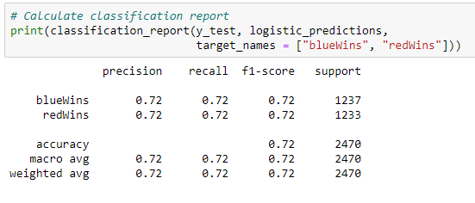
Logistic Regression Result

Slide 19
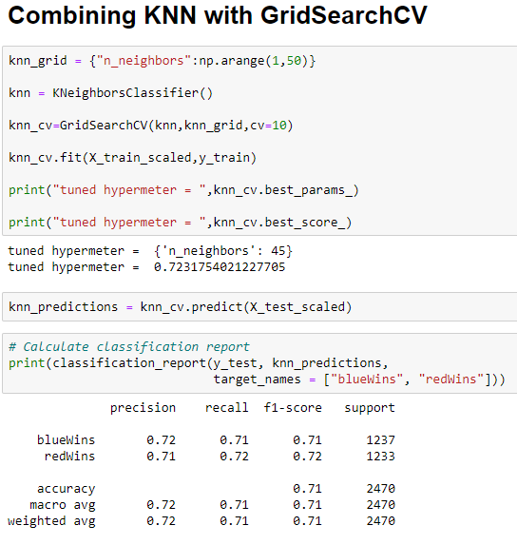
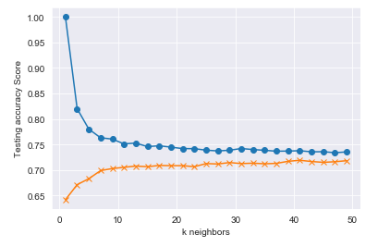
KNN Result

Slide 20
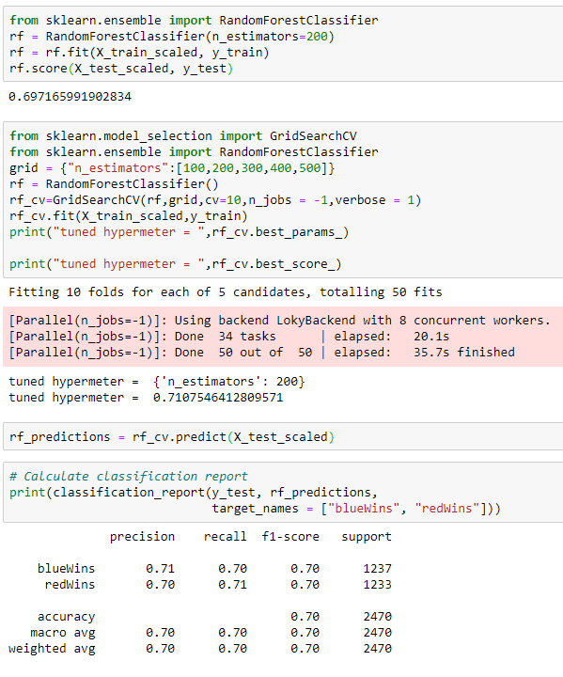
RandomForestClassifier Result

Slide 21
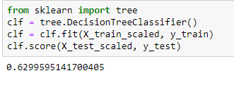
Decision Tree Result

Slide 22
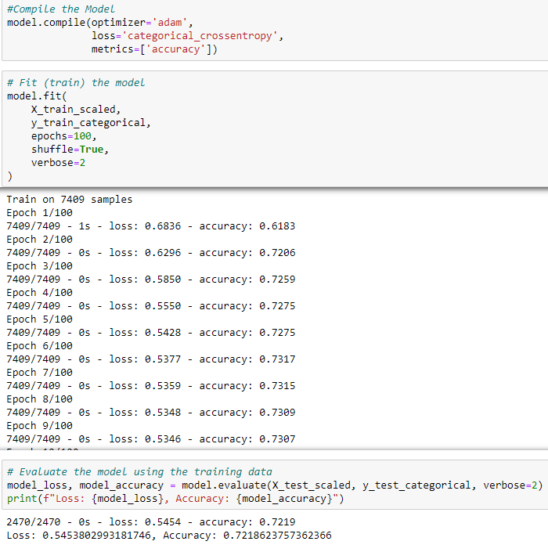
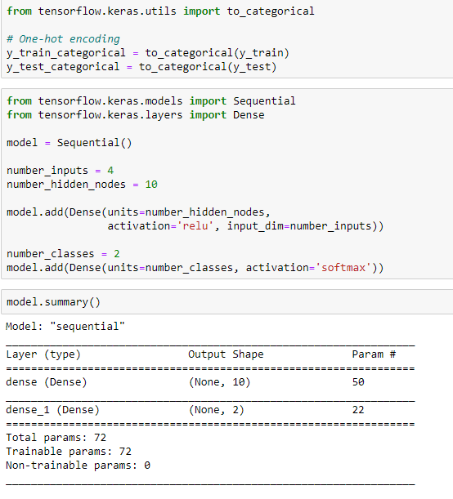
Neural Network

Slide 23
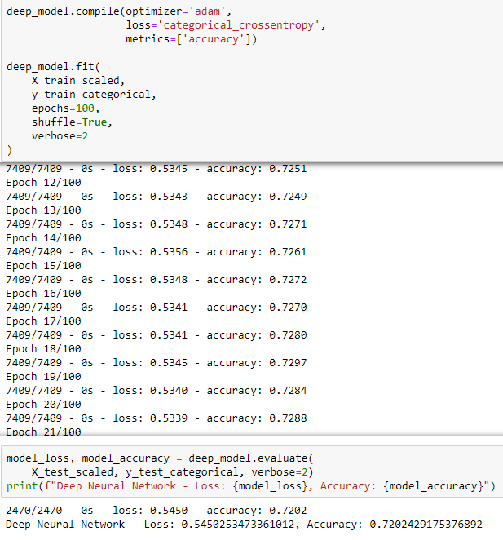
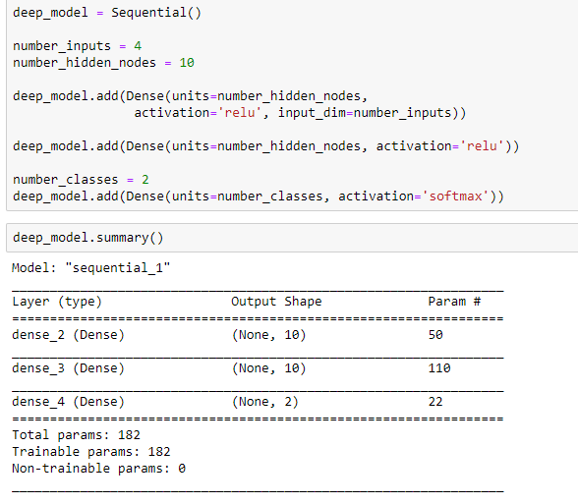
Deep Learning

Slide 24
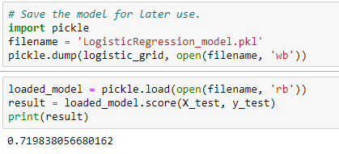
Save Model

Slide 25
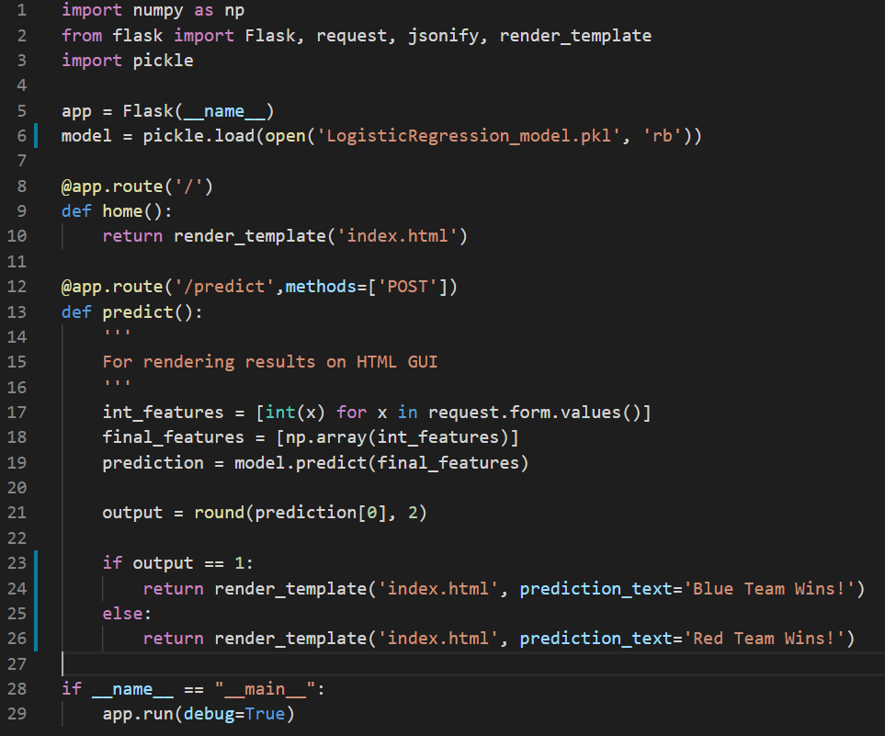
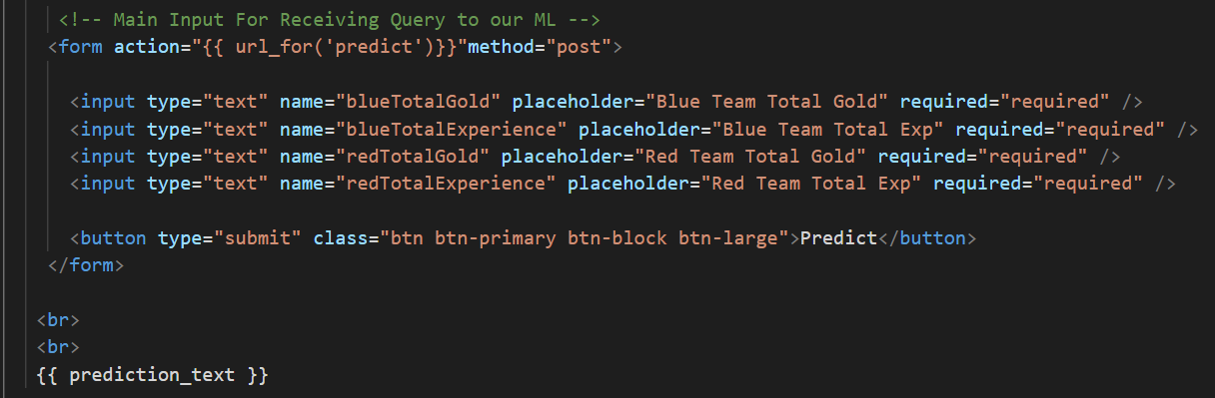
Deploy Machine Learning Model Using Flask

Slide 26
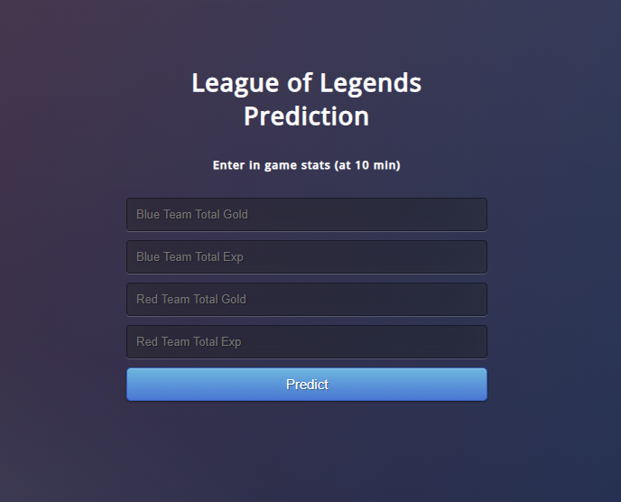
Deploy on Heroku
https://league-predict.herokuapp.com/

Slide 27
Questions?

